Slide 1
Modern approaches
State-of-the-Art

Slide 2
Detection: Taxonomy
Detectors
Two-Stage (Proposal-based)
RCNN
Fast RCNN
Faster RCNN
Mask RCNN
One-Stage
SSD
YOLOv3
DSOD
RFBNet
Points-based
CenterNet
CornerNet
ExtremeNet
EfficientDet (NAS)
Time

Slide 3
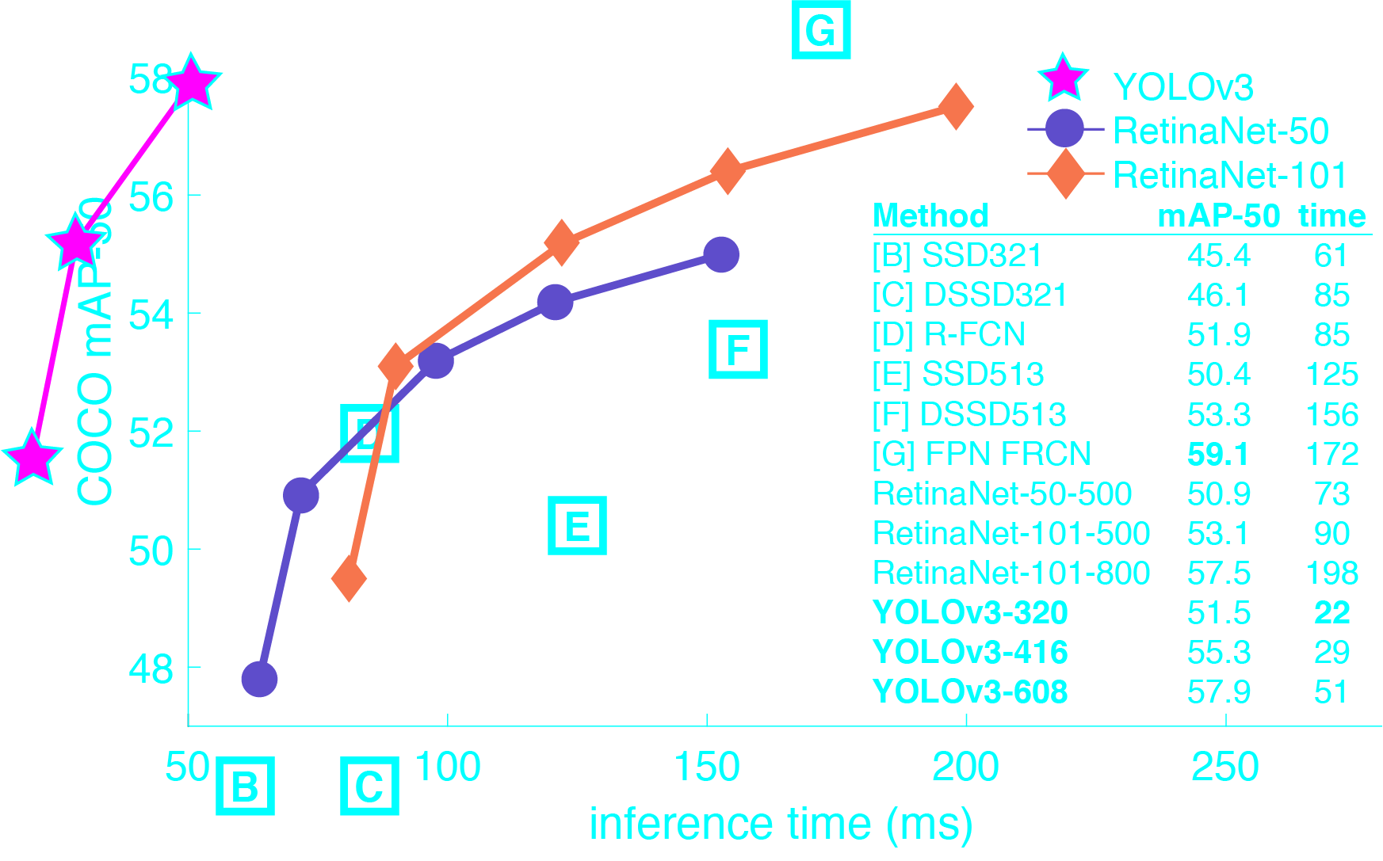
Incremental improvement: YOLOv3 (2018)
https://pjreddie.com/darknet/yolo

Slide 4
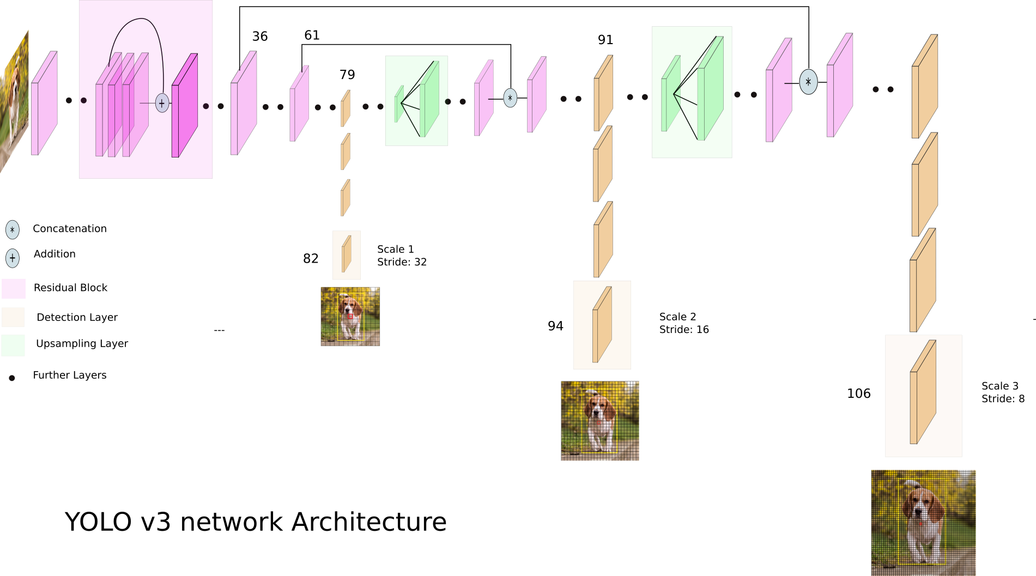
Incremental improvement: YOLOv3 (2018)

Slide 5
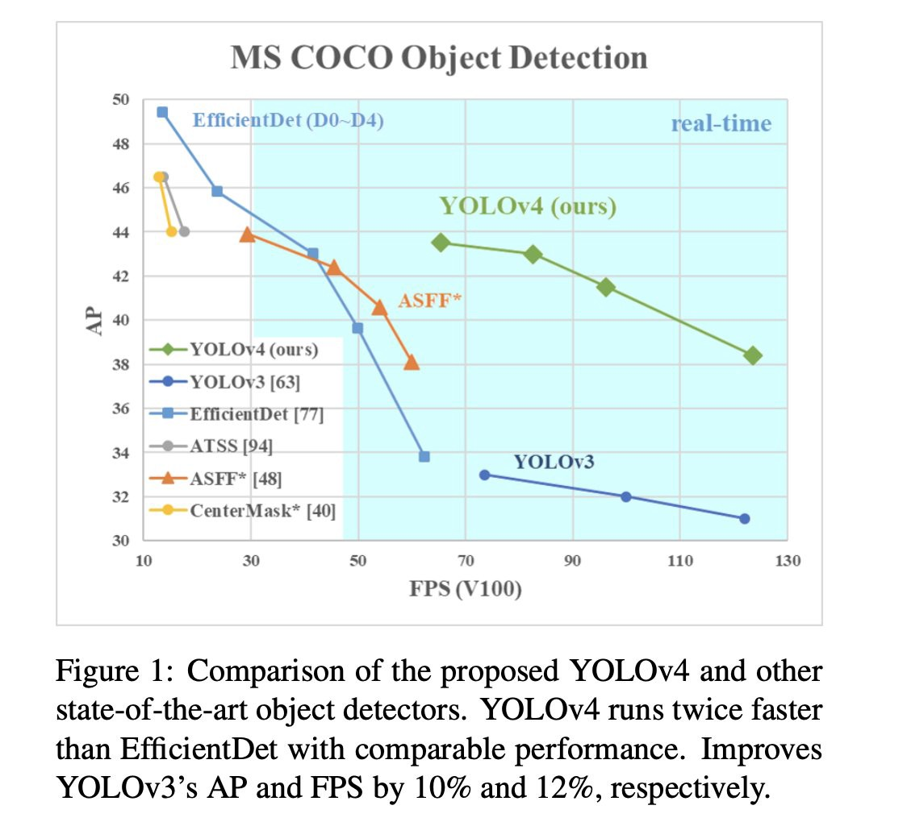
Optimal detection: YOLOv4 (2020)
https://habr.com/ru/post/503200/

Slide 6
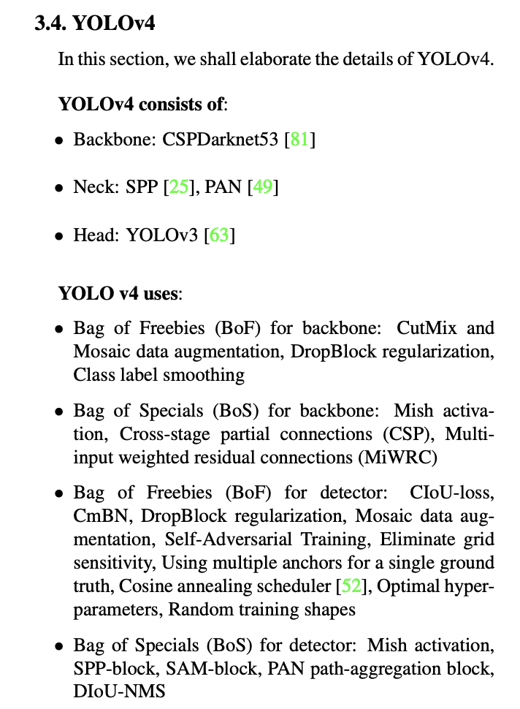
Optimal detection: YOLOv4 (2020)
https://habr.com/ru/post/503200/

Slide 7
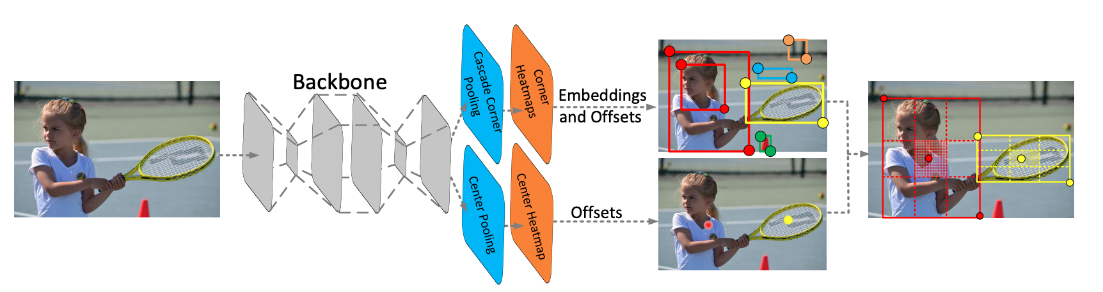
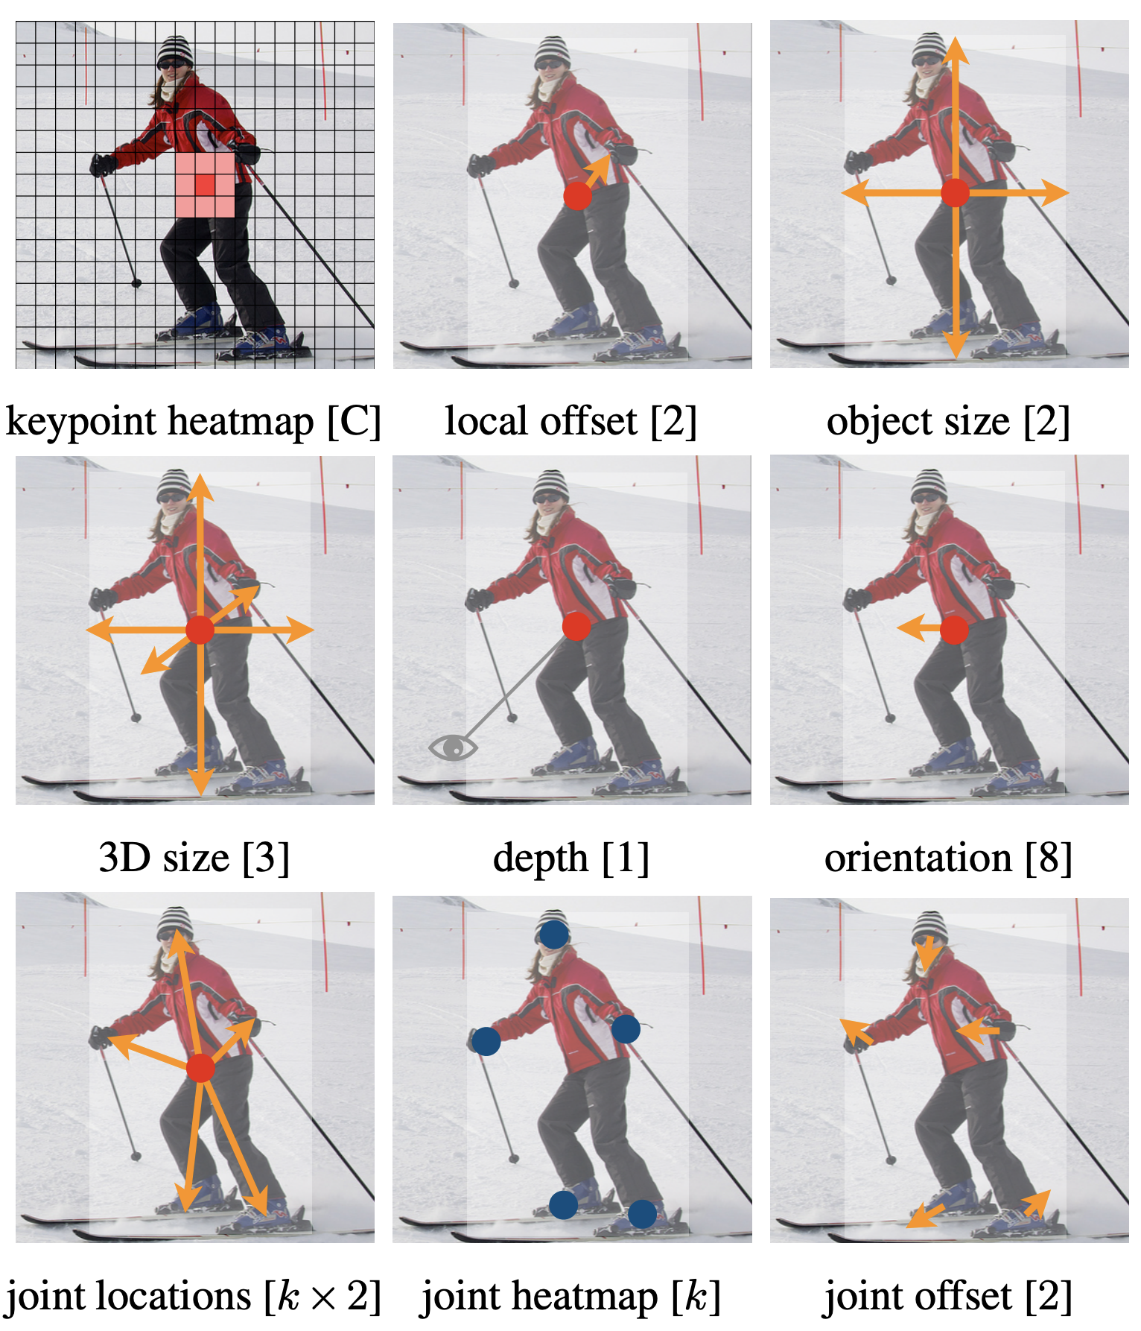
Objects as Points: CenterNet (2019)
https://arxiv.org/abs/1904.07850

Slide 8
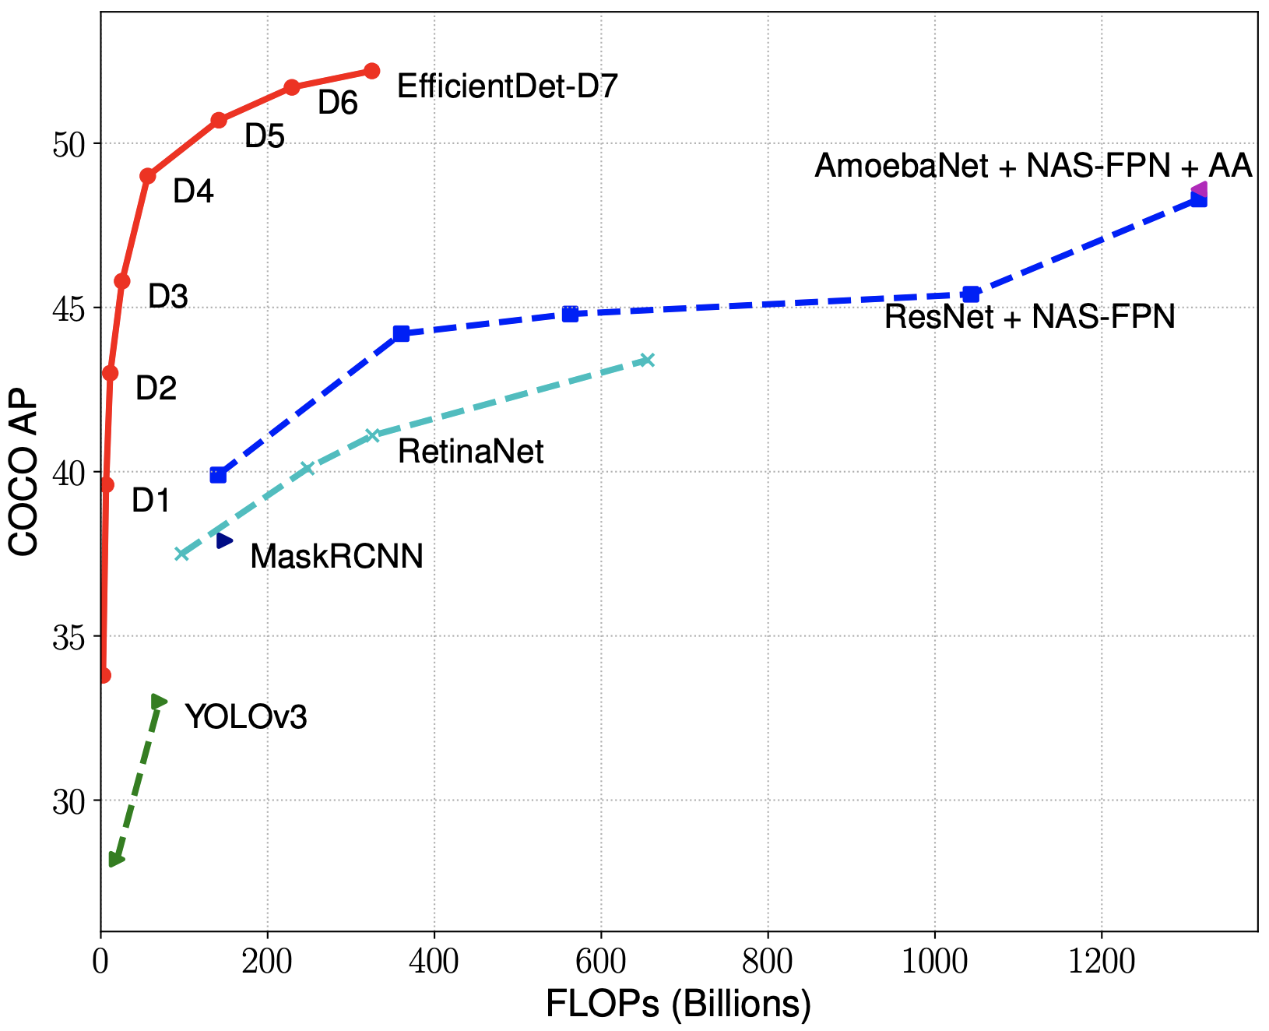
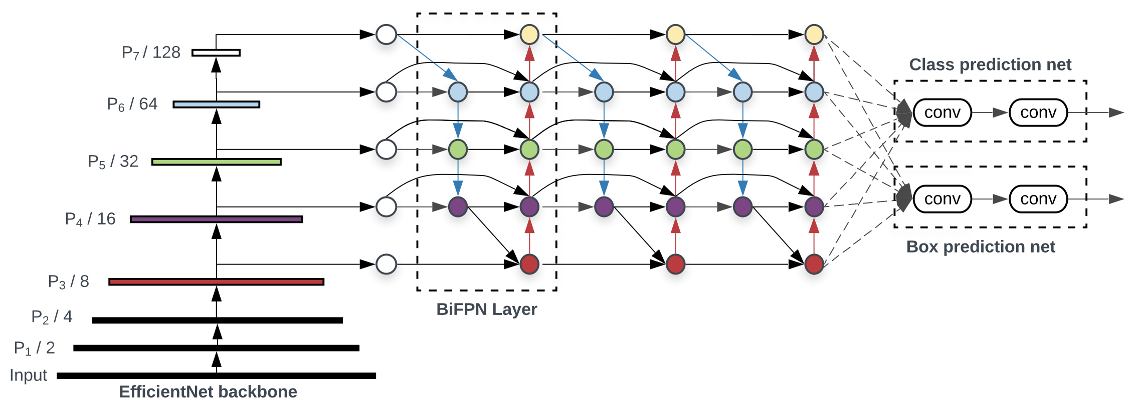
NAS in Detection: EfficientDet (2019-2020)
Idea: EfficientNet + BiFPN
https://github.com/google/automl/tree/master/efficientdet

Slide 9
Modern tasks
Specific detection applications

Slide 10
In real life we need to
Detect people
Detect faces
Detector text
Do tracking through the video (time), not only image
Recognize actions: proxy, end-to-end
Detect in 3D: self-driving, robotics, VR/AR

Slide 11
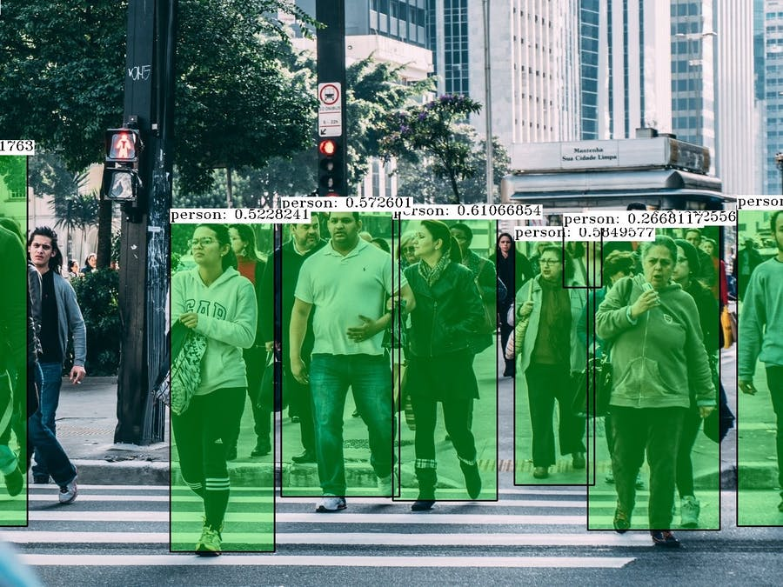
In real life we need to: detect people

Slide 12
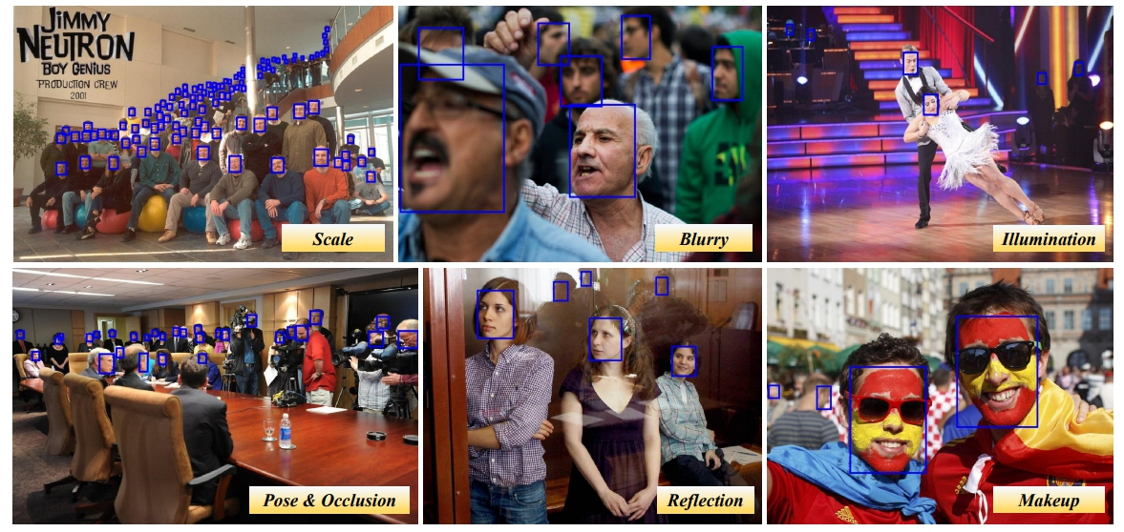
In real life we need to: detect faces

Slide 13

In real life we need to: detect text

Slide 14
In real life we need to: do tracking

Slide 15
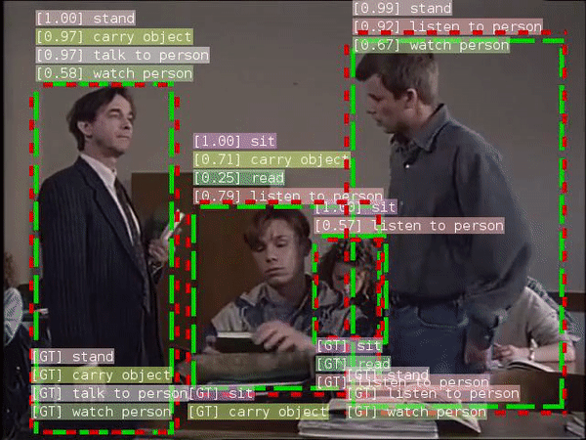
In real life we need to: recognize actions
https://github.com/facebookresearch/SlowFast

Slide 16
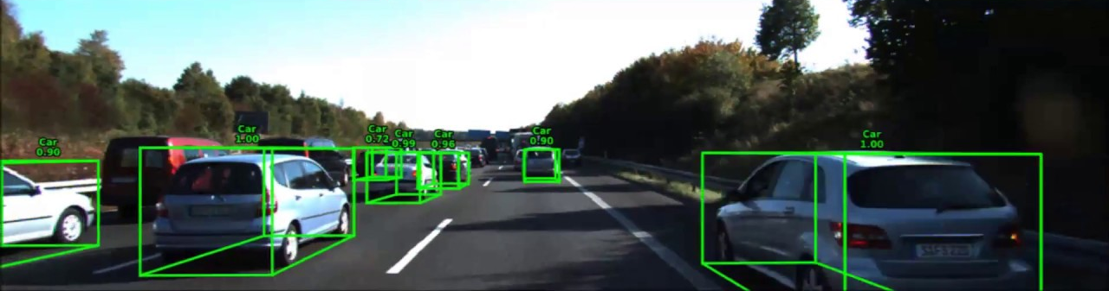
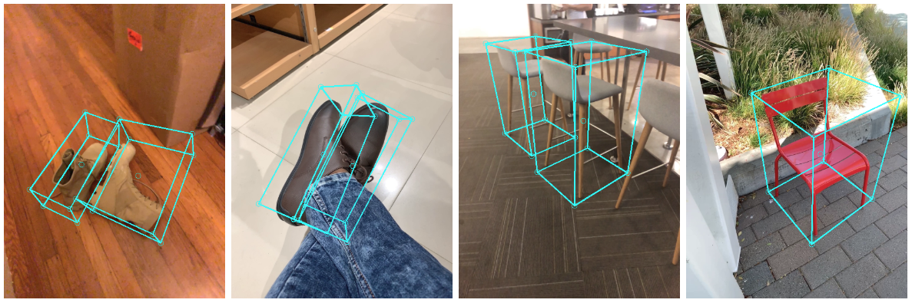
In real life we need to: detect in 3D
https://google.github.io/mediapipe/solutions/objectron

Slide 17
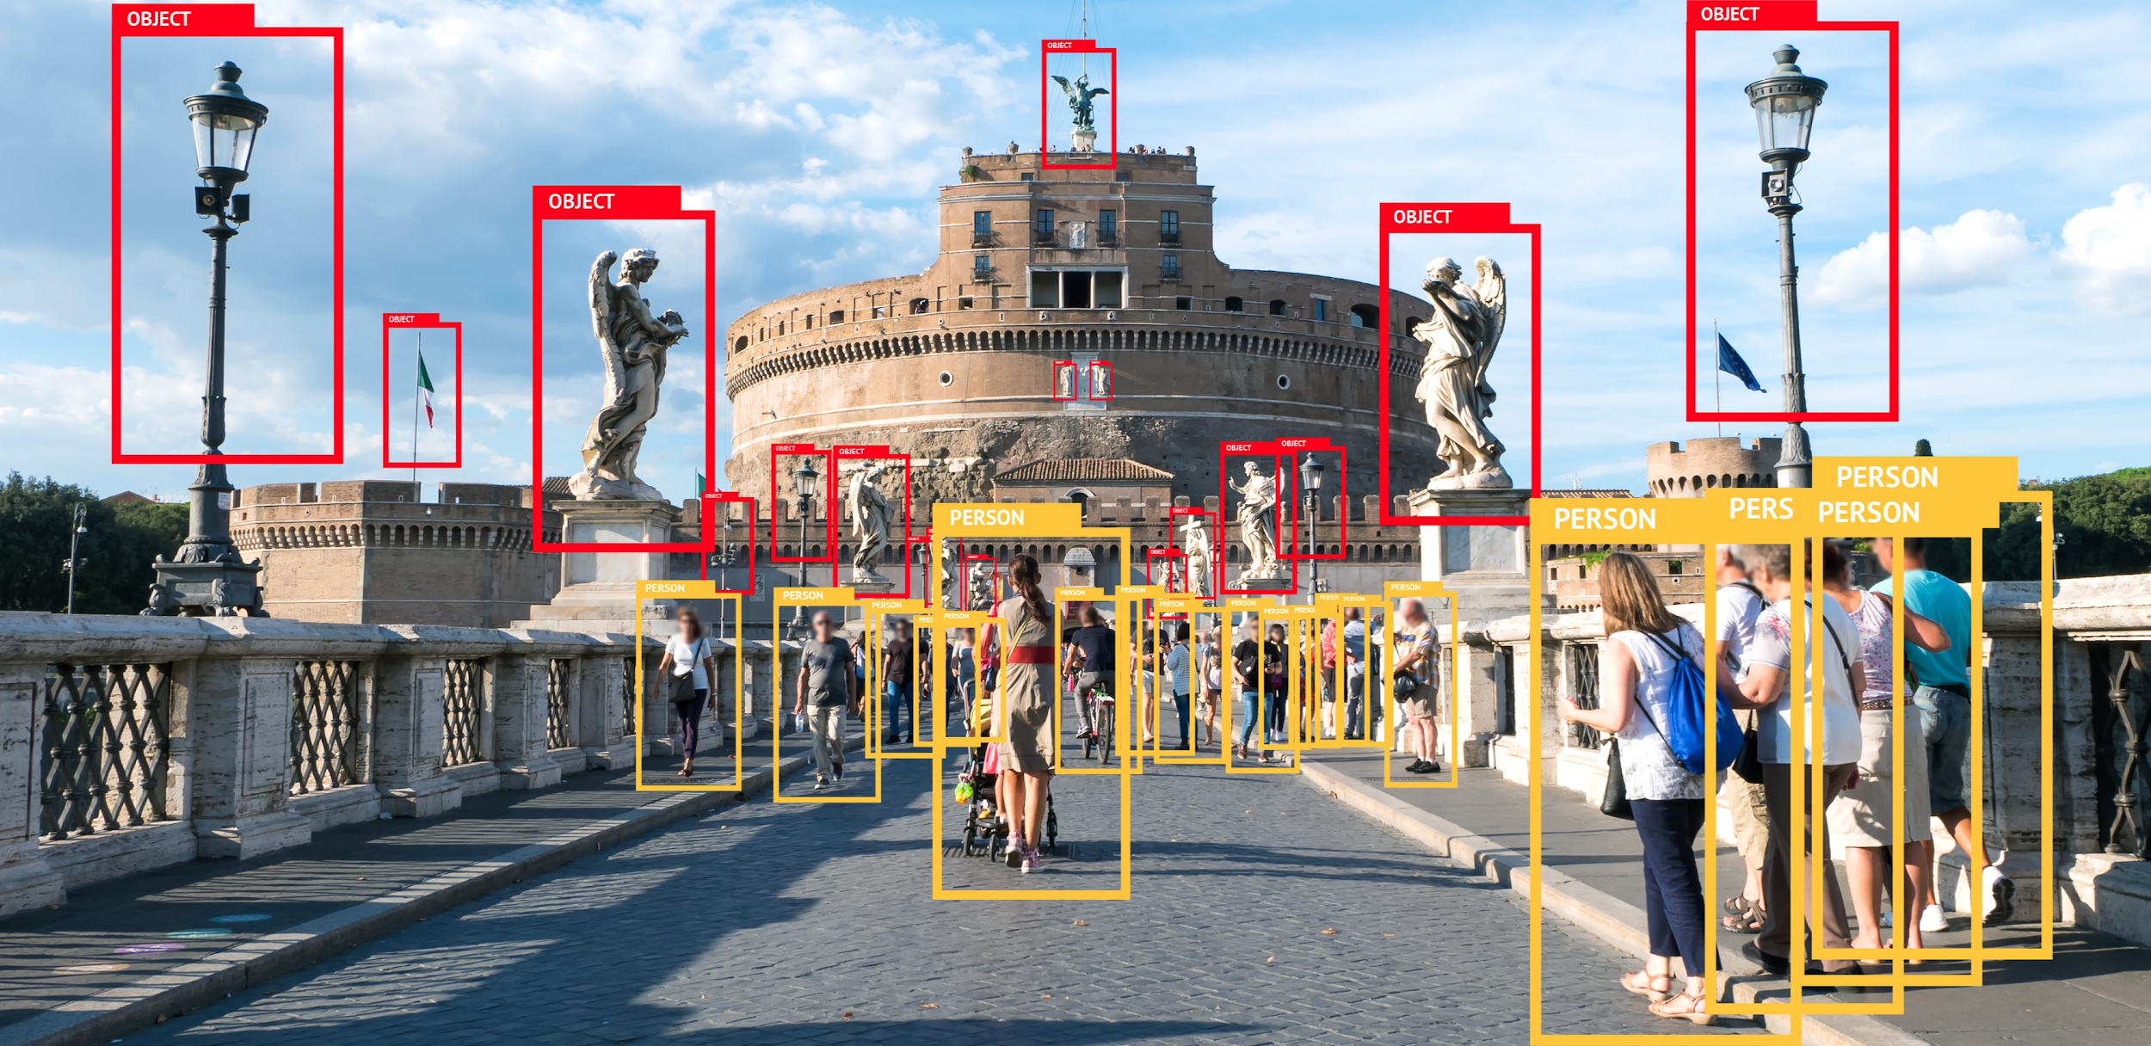
Solutions to these tasks
https://habr.com/ru/company/mipt/blog/458190/

Slide 18
Lecture summary
Classification recap
Object Detection basics
Two-stage (proposal-based) methods
One-stage (single-shot) methods
Modern approaches & tasks

